Slide 1
Project presentation on Raisin
Name :- Dhruvesh Bhatia

Slide 2

Name:Dhruvesh Bhatia
Education
Skills
Contact
Data Analytics from Imarticus Learning with Distinction
BE in Mechanical with First Class
Diploma in Mechanical with First Class
Address:
# Rauth Mala Behind Sitban Lawn Ahmednagar
SQl
Python
Machine learning
Contact Numbers:
8329537748
Power BI
Deep learning
Email Address:
bhatiadhruvesh@07gmail.com
Work Experience
ACE Pneumatic (2020-22)
Languages
Designation Quality Engineer
I was handling all the Quality from input to output of job
As well I was having sample inspection on shop flor in production department and maintance department
Hobbis
Englih
Hindi
Video
Music
Travelling
Fixed Gear
Marathi

Slide 3
Problem Statement
In this dataset we have to predict the type of raisin by applying ML algorithm
pro

Slide 4
Workflow
We have collected data from UCI
We have perform EDA
Apply ML algorithm
Compare performance
Concluded the Best ML algorithm for prediction

Slide 5
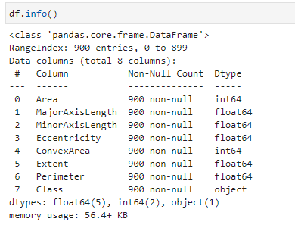
Information of data set

Slide 6
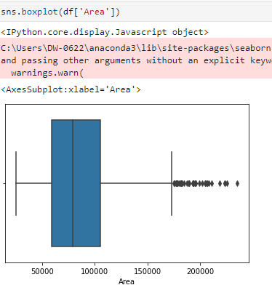
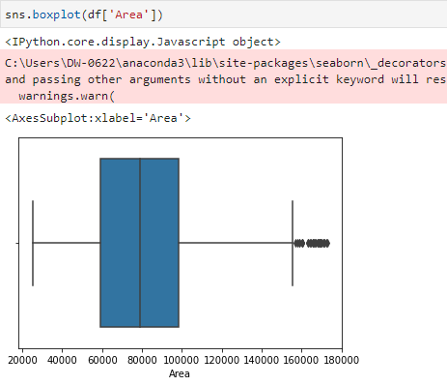

Slide 7
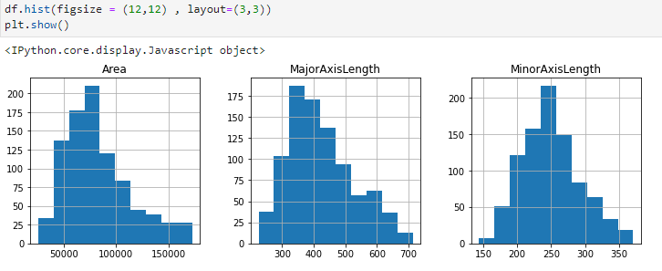
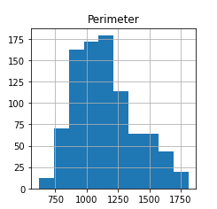
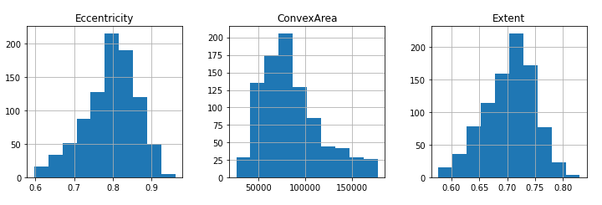
We Have check the distribution of data by using histplot

Slide 8
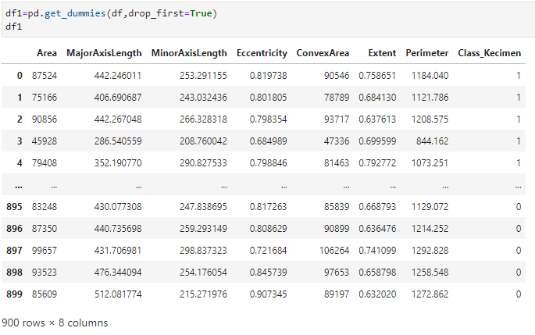

Slide 9
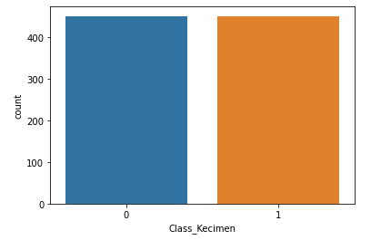
Hence All EDA Part is done now data is ready for ML Algorithms

Slide 10


Converting Dataset in X and Y variable
In X variable we have consider all the feature eliminating target
In Y variable we have consider target column
We have done standardization for X variable
We have converted data into train test split
Apply ML algorithm

Slide 11
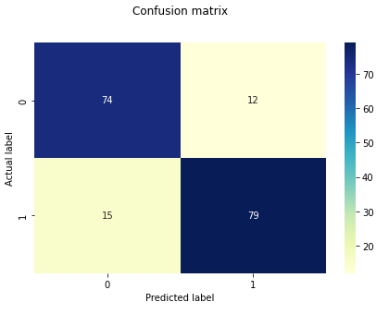
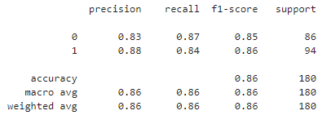

Logistic Regression

Slide 12
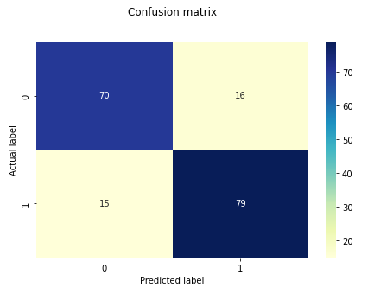
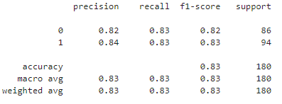

KNN

Slide 13
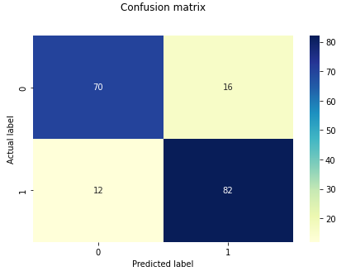
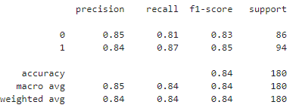

Cross Validation for KNN
train: 1.0
test: 0.8444444444444444

Slide 14
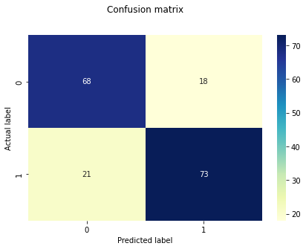
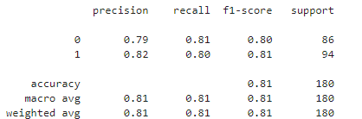

Decision Tree

Slide 15


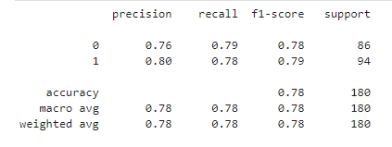
Cross Validation for DT

Slide 16
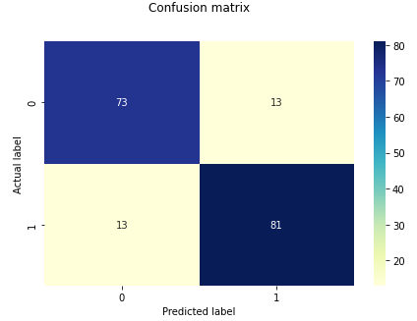
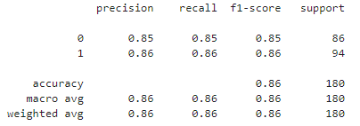

Random Classifier

Slide 17
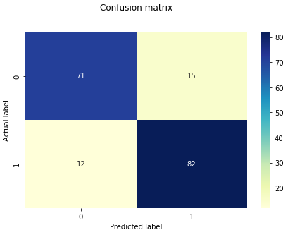
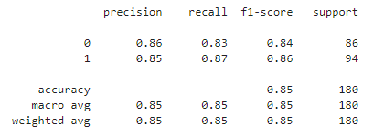

Support vector classifier

Slide 18
 | Models | Train Acc | Test Acc | Roc
 | Logistic | 0.86 | 0.85 | 0.85
 | KNN | 0.88 | 0.82 | 0.82
 | Cross_valid_KNN | 0.86 | 0.84 | 0.84
 | Decision Tree | 1.00 | 0.78 | 0.78
 | Cross_valid_DT | 0.90 | 0.83 | 0.83
 | Random Forest | 1.00 | 0.86 | 0.86
 | SVM | 0.87 | 0.85 | 0.84
 | Naive_bayes | 0.84 | 0.86 | 0.86
 | Adaboostclassifier | 0.90 | 0.83 | 0.83

Slide 19
Conclusion
After comparing all the performance measure of all the algorithm we get the best result SVC. Hence for further prediction we will use SVC

Slide 20
THANK YOU

